Slide 1
NSS Capstone
Evolution of Clean Transportation
Tom Hudson
DDA-5

Slide 2
Electric Vehicle does NOT equal Zero Emissions
FACTS:
Electric Vehicles (EV’s) have no tailpipe emissions
Electricity Generation by Renewable Sources = 20% of Electricity consumed
80% of electricity used in EV’s generate greenhouse gasses
Outcome:
EV’s are cleaner than gasoline or diesel vehicles, but only by roughly 20%; at this point, not a stand-alone solution to the environment

Slide 3
State of U.S. Environment and Impact
2020 – 2nd warmest year on record – NEGATIVE IMPACT
All States, especially the Northeast, have become warmer over the past century – NEGATIVE IMPACT
Average rainfall is 5% higher at the beginning of the 21st century than it was at the beginning of the 20th century – UNKNOWN IMPACT
States in the Northeast and along the Mississippi are getting more precipitation – UNKNOWN IMPACT
In 1980, the average U.S. county have good air quality 59% of days. In 2020, that rose to 88% of days – POSITIVE IMPACT
Source: Environment and Climate | 2021 State of the Earth Facts (usafacts.org)

Slide 4
Items for Discussion
What is the current state of Clean Electricity Generation?
Can we make progress toward Green Energy and Reduced Emissions?
Are Electric Vehicles (EV’s) a viable alternative to fossil-fuel, powered vehicles?

Slide 5
Items for Discussion
What is the current state of Clean Electricity Generation?
Can we make progress toward Green Energy and Reduced Emissions?
Are Electric Vehicles (EV’s) a viable alternative to fossil-fuel, powered vehicles?

Slide 6
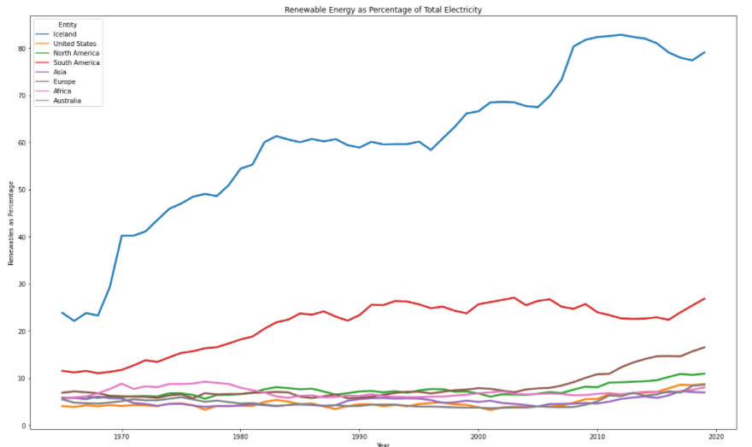
Electricity Generation by Renewable Methods

Slide 7
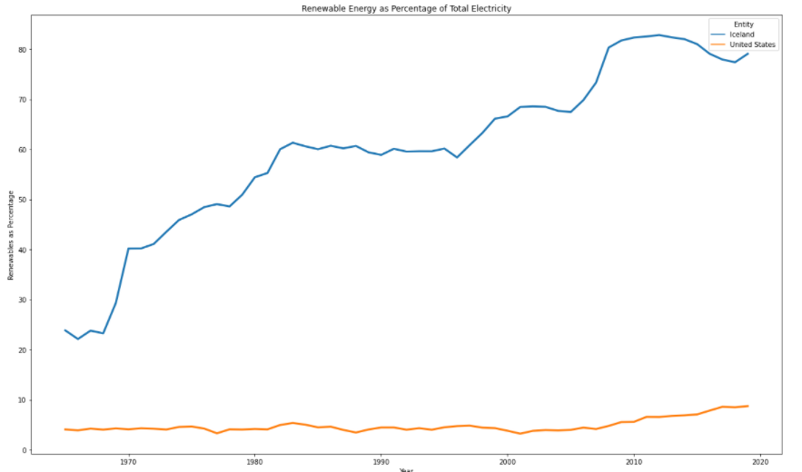
Electricity Generation by Renewable Methods

Slide 8
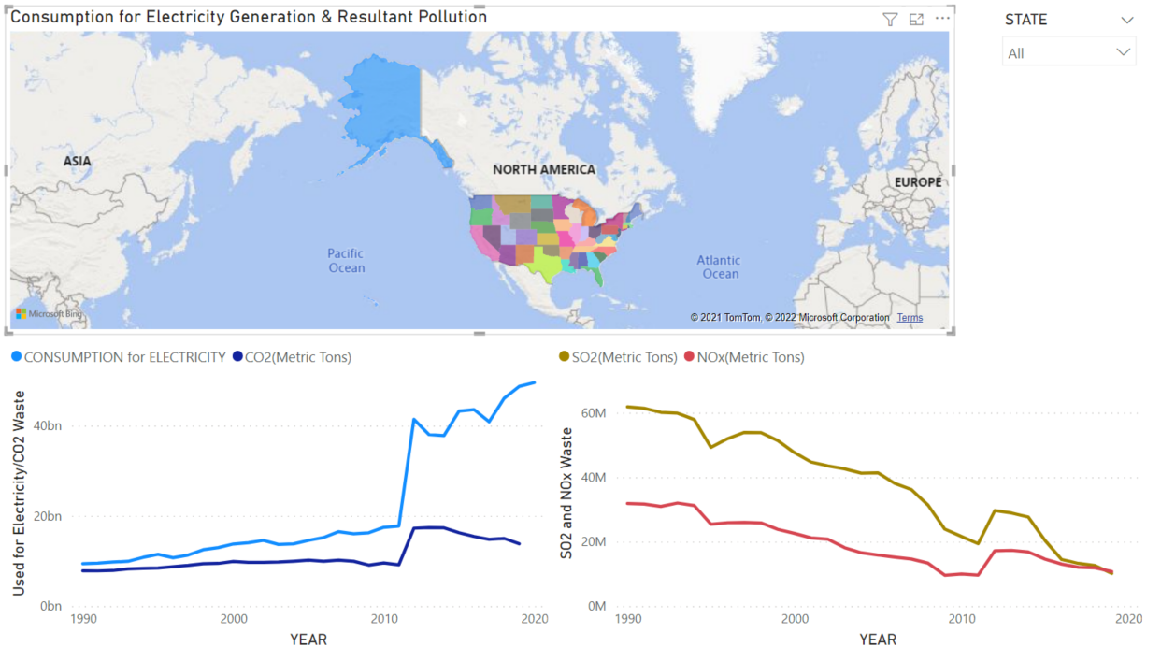
Power BI – U.S. Dashboard

Slide 9
Items for Discussion
What is the current state of Clean Electricity Generation?
Can we make progress toward Green Energy and Reduced Emissions?
Are Electric Vehicles (EV’s) a viable alternative to fossil-fuel, powered vehicles?

Slide 10
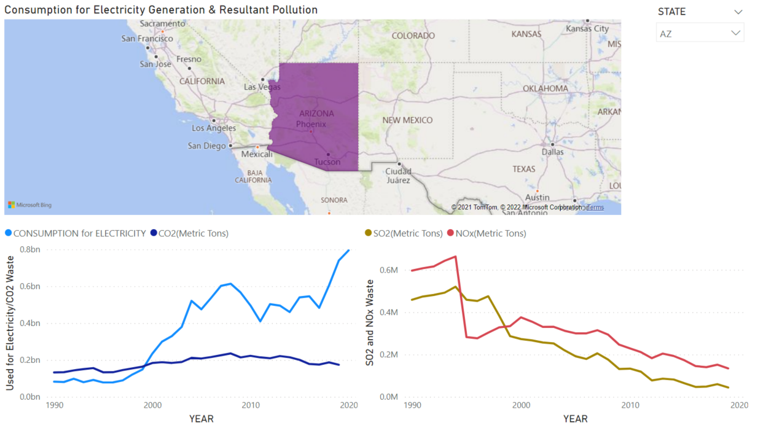
Power BI – Arizona Dashboard

Slide 11
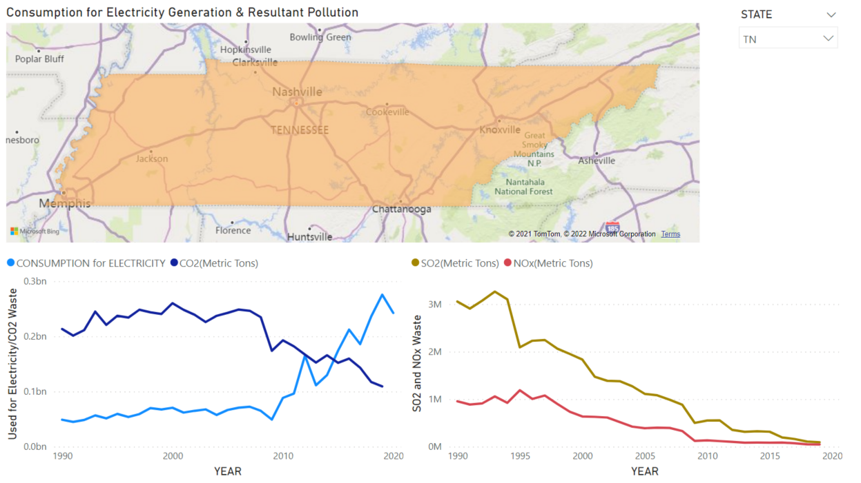
Power BI – Tennessee Dashboard

Slide 12
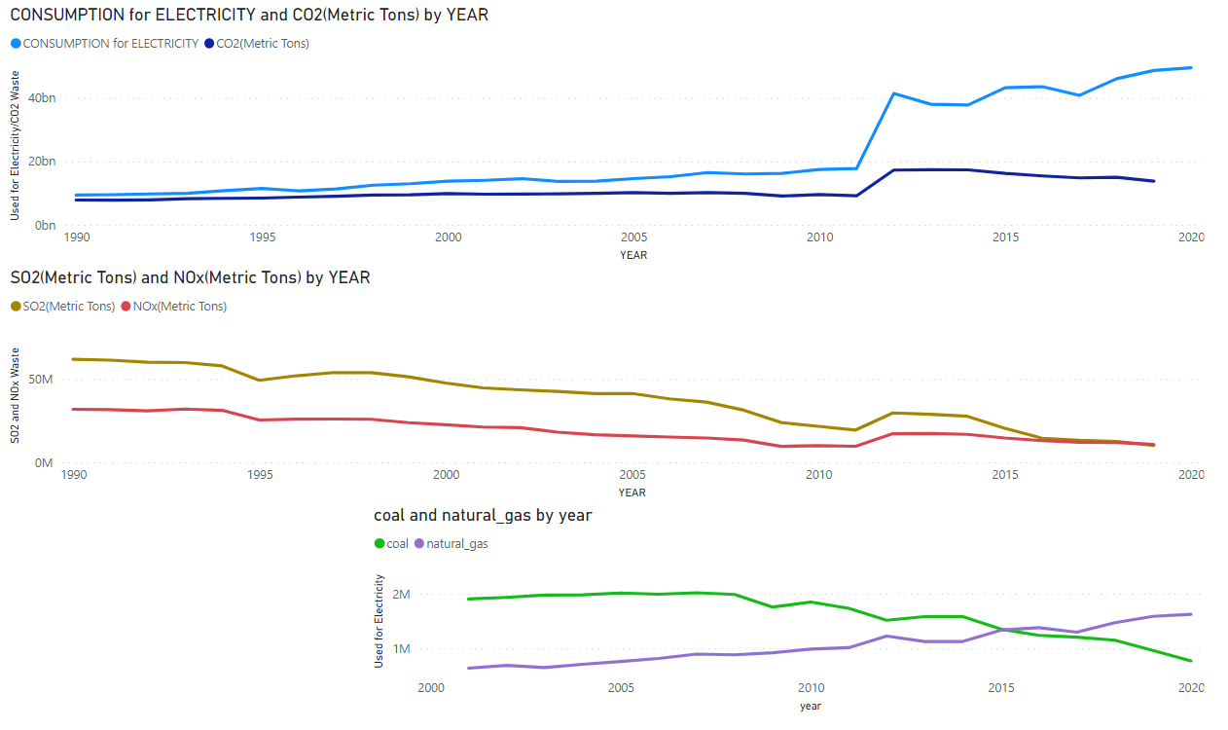
Power BI – Impact of Natural Gas
Spike & lesser spike
Natural Gas as primary fuel

Slide 13
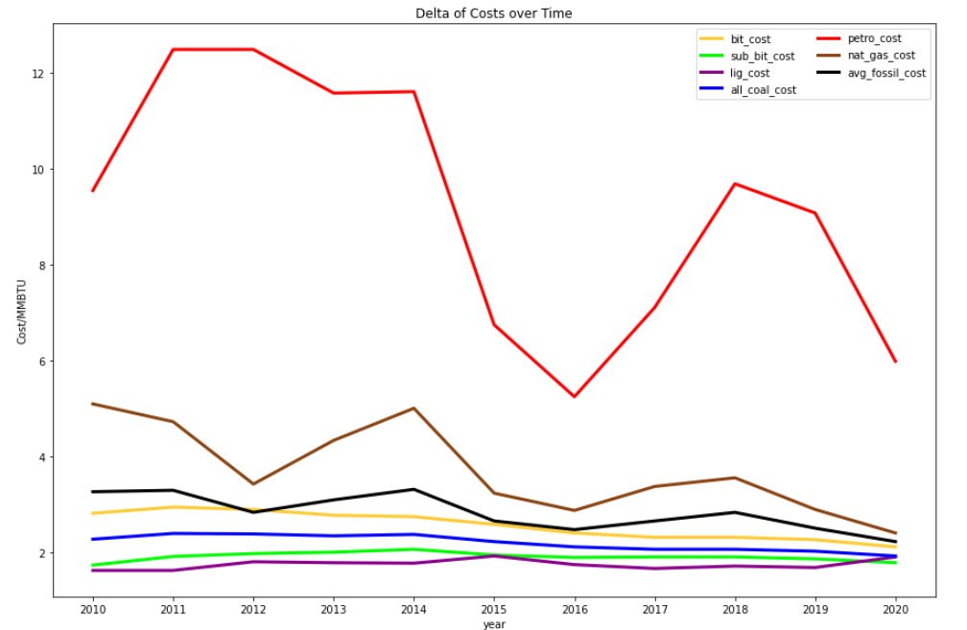
Cost of Fossil Fuels

Slide 14
Current Events in the U.S.
Executive Order signed December, 2021 –
60% emissions reduction from Federal Operations by 2030, including a Carbon-Free power goal using electricity produced only from sources that do not emit carbon dioxide and locally supplied
100% zero-emissions light-duty vehicle acquisitions by 2027
Net-Zero emissions by 2050 (buy clean policy) to encourage using construction materials made with fewer carbon emissions and eliminating “forever chemicals” linked to cancer and found in drinking water supplies
SOURCE: ICYMI: President Biden Signs Executive Order Catalyzing America’s Clean Energy Economy Through Federal Sustainability | The White House

Slide 15
Emerging Technology in Electricity Generation
According to Drax:
Microbial Fuel Cells – harnessing the power of bacteria
Solar Power – solar voltaic glass and solar PV paint
Betavoltaics – utilizing nuclear waste to generate electricity
Tidal Power – underwater turbines for tidal power stations
Source: 4 of the most exciting emerging technologies in electricity generation (drax.com)

Slide 16
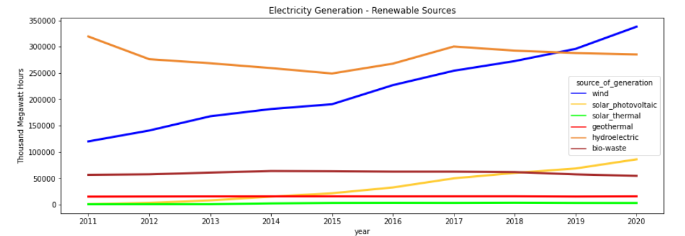
Electricity Generation – Renewables (U.S.)
Wind, with a sharp rise, more than doubles in output during the decade
Solar-Photovoltaic shows a similar rise, but from a much lower starting point

Slide 17
Items for Discussion
What is the current state of Clean Electricity Generation?
Can we make progress toward Green Energy and Reduced Emissions?
Are Electric Vehicles (EV’s) a viable alternative to fossil-fuel, powered vehicles?

Slide 18
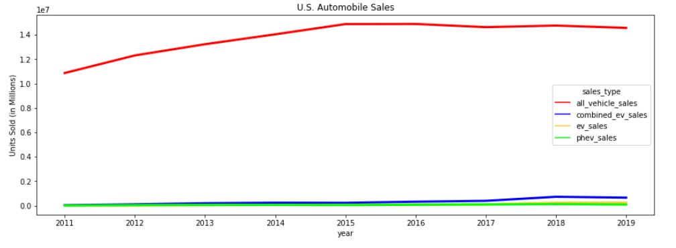
U.S. Light-Duty Vehicle Sales (All)

Slide 19
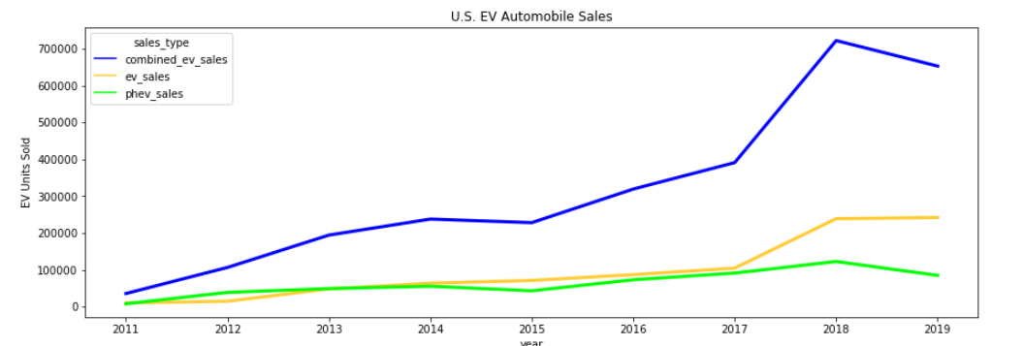
U.S. Light-Duty Vehicle Sales (EV only)

Slide 20
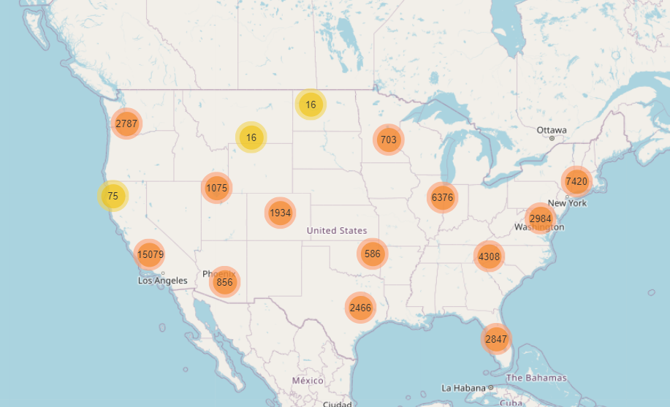
Public Recharging Stations
More than 49,000 exist as of 2021

Slide 21
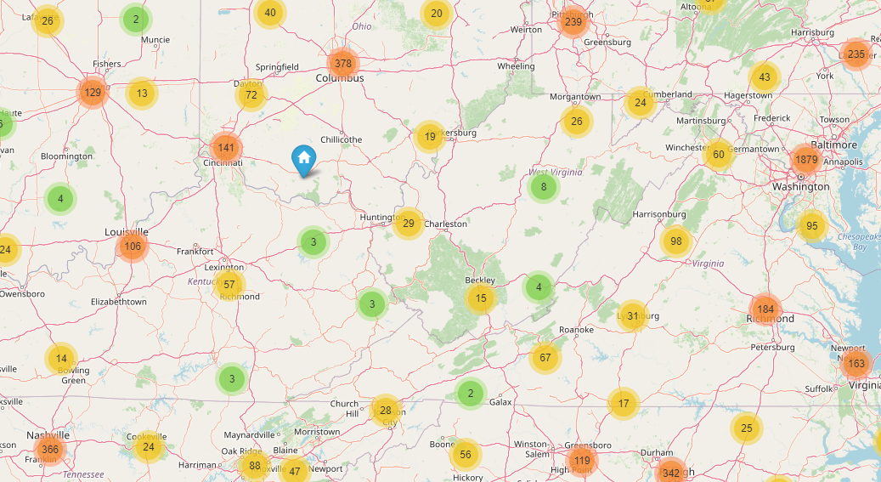
Nashville to Hershey, PA in an EV
Destination
Refueling Stop

Slide 22
Thoughts at the End of the Day
Gasoline Vehicle
Driving distance = 100 miles
25 MPG
Uses 4 gallons
@ $3.00/ gallon
Cost of travel (fuel only)
$12.00
Electric Vehicle
Driving distance = 100 miles
Uses 36.4 KwH
@ $0.13 /KwH (national avg)
Cost of travel(electricity only)
Home charge cost = $4.76
Public charge costs vary but should range between $6 & $16
Source: We Know How Much Evs Will Raise Your Electricity Bill | 21Oak

